Slide 1
Intellectual Property (IP) | TMT | Corporate/Commercial | Tax | RERA | Banking | Media and Entertainment |Arbitration
Offices:
Delhi | Gr. Noida (NCR) | Bangalore | Chennai | Hyderabad | Indore | Mumbai | Pune | Punjab
US | UAE/GCC | Malaysia | Thailand | Vietnam | Bangladesh | Myanmar | Nepal | Sri Lanka | Indonesia
W: www.iiprd.com | www.khuranaandkhurana.com
E: iiprd@iiprd.com | info@khuranaandkhurana.com

Slide 2
OVERVIEW
About IIPRD
IIPRD is an established IP Asset Management Practice Firm focusing on Comprehensive Patent Support Services, Litigation Support, and Licensing/Commercialization Mandates for Global Corporates, Law Firms and Licensing Firms. IIPRD also extensively focuses on conducting IP Audits, Due-Diligence Exercises, IP Valuations and the complete range of Patent Support Services spanning from Illustrations/IDS Preparation Support, Docketing/Paralegal Support, Undertaking Patent Searches (Patentability, Validity, FTO, Landscape and Analytics), Preparation/Prosecution to Litigation Support Services.
About Khurana & Khurana
Khurana & Khurana is a leading Chambers, Legal 500, Managing IP, IAM, Asia-IP, RSG, Acquisition-INTL, Corp-INTL, and Benchmark Litigation recommended/ranked full service Law Firm in India with exclusive offices in the US, Malaysia, Sri Lanka, Thailand, Indonesia, UAE/GCC, Bangladesh, Vietnam, Nepal and Myanmar. K&K represents Indian and International clients ranging from small start-ups to Fortune 100 companies through its team of around 240 professionals spread across 10 offices in India. The firm focuses comprehensively on all aspects of IP, Commercial/Corporate/Company Law, Arbitration, RERA/Property, TMT, Banking and Media/Entertainment Matters. K&K takes strong pride in having client-centric approach, being prompt in communications across departments, and being flexible to client requirements and expectations to help achieve desired objectives at the right cost structure.

Slide 3
Media and Entertainment law practice in India
Khurana & Khurana, Advocates and IP Attorneys

Slide 4
About Media and Entertainment Law
At the heart of it, entertainment industry is a colorful, vibrant, and ever evolving experience, however to be able to function the way it does, a lot of laws come in play.
Different stakeholders in the ecosystem each have separate rights that protect them.
Indian Copyright Act is one of the main players ensuring that each person/stakeholder involved in any work is adequately protected.
Practice in media and entertainment law revolves around transactions that relate to daily activities of various stakeholders, such as production houses, ott platforms, individual producers, directors, screenwriters, actors, singers, lyricists, composers talent mangers, advertising agencies etc.
Over the years we have evolved to form stronger and robust mechanisms to carry out smooth transaction within the industry.

Slide 5
major stakeholders
OTT Platforms
Artists and Managers
Advertisement Agencies
Film Production Houses
Music Production
Houses​
Screenwriters, Directors, Composers, Lyricists, Singers Etc.

Slide 6
The Media and entertainment practice at khurana & Khurana (Films)
K&K has worked with various known production houses of the country and several other global players on matters that relate to acquisition of rights for film projects, drafting and negotiating film deals, trademark registrations, complete film documentation and agreements such as –
Production Agreements
Film Director Agreement
Associate, Creative, Line, Art producers’ Agreements
Script review and due diligence
Script legal research and vetting
Location agreements
Screenwriter’s Agreement
Agreements with the Cast
Screenplay Agreement
Content Licensing Agreements
Sale and Transfer of IP
Content Distribution Agreements
Local Channel Network Agreement
App Integration Agreement
Assignment Agreement
Litigation Assistance
Post Production Agreements and related transactions
Standard & Practice Mandate

Slide 7
The Media and entertainment practice at khurana & Khurana (Music)
K&K has worked with various known music production houses, singers, composers, lyricists etc. within the country and with international talents on cross border rights acquisitions and related transactions. A few mandates that we have assisted our clients with include-
Music Production Agreements
Synchronization Agreements
Music Composition Agreement
Assignment of Rights Agreement
Royalty acquisition mandates
Content distribution Agreements
Exclusivity Agreements
Legal notices for non-payment
Music remake Agreements and acquisition of related rights
Copyright infringement mandates
Cover version and remix permissions
Public Performance Agreements
Agreements and documentation for Tours.

Slide 8
The Media and entertainment practice at khurana & Khurana (MISC)
K&K has assisted various directors, costume designers, post production houses, advertisement agencies, influencers and talent managers in facilitating transactions that relate to their day-to-day activities. A few of such mandates include-
Talent Management Agreement
Brand Endorsement Deals
Work for hire agreement
Service Provider Agreements for post production related activities
MSAs drafted and vetted for Post Production houses along with related Pos
ASCI compliance mandates
Notices and replies for ASCI non-compliance
Trademark registration for Celebrity Names
Notices for non-payment by brands
Legal notices for non-payment
Copyright infringement mandates
Personality rights infringement mandates

Slide 9
Exemplary LITIGATION(& PRE-LITIGATION ASSISTANCE
Trademark Litigation against Republic TV
Notice to Qubo Smart Lock for unauthorized use of script
We are defending our client R TV, a Telegu news channel, who using the trademark with the letter ‘R’ against Republic TV in a trademark infringement suit.
Our client Cellar Door Productions came to us with an alleged infringement of their script by Qubo Smart Locks. We assisted them with a legal notice to the company.
Notice to BharatPe for unauthorized use of licensed advertising content for IPL
Legal Notice for Ullu Digital Pvt. Ltd
Our client, Cutting Crew Studio had approached us for the unauthorized use of their content for an IPL campaign by BharatPe. We have assisted them by in negotiations and pre-litigation support.
We have assisted our client Ullu Pvt. Limited in handling claims and replying to take down notices for the public exhibition of their content.
Khurana and Khurana has assisted various clients in litigation and pre-litigation mandates. Due to the nature of such transactions and clients, we can only name a few instances with basic information on the assistance rendered by us.
Multiple Copyright infringement cases
ASCI Compliance for WOW Skin Sciences
Our client N.V. Kasi is a best selling author in the romance genre and we have been lending litigation support to her on various copyright infringement matters.
We have drafted replies for our client WOW Skin Sciences in notices from ASCI for alleged non-compliance of the ASCI self regulatory mechanism.

Slide 10
Key Practitioners
Tarun Khurana (Partner and Patent Attorney - Software/Electronics/Mechanical Group)
Abhijeet Deshmukh (Associate Partner and Advocate - Litigation)
Tarun has over 24 years of experience in a broad range of Intellectual Property (IP) subject matters, and is the Co-Founding Partner and IP Attorney of Khurana & Khurana (K&K) and of its IP Asset Management & Market Research Practice, IIPRD, both of which are among the Leading IP and Commercial Law Practices with 10 Offices in India, and over 240 Professionals.
Tarun has a strong experience in IP and Commercial/Corporate Litigation Matters and has actively represented several Global entities for their IP rights and Contract Enforcement Matters. Tarun is ranked among the leading IP Practititioners in India and is highly ranked by Chambers and Partners, IAM, Managing IP, Legal 500, among others.
Abhijeet Deshmukh is an Associate Partner with Khurana & Khurana, Advocates and IP Attorneys. He specializes in all aspects of Intellectual Property, Contractual laws, Corporate Advisory and Litigation with focus on IP and Commercial disputes; UDRP disputes; Prosecution of Trademark and Copyright Applications.
He represented clients in disputes pertaining to IP and Commercial Law at Various Judicial and quasi-judicial Authorities across India. He has also worked extensively on advising, negotiating, drafting, vetting and structuring various Agreements related to Intellectual Property laws such as Technology Transfer Agreements, IP Assignment Agreements, Strategic Alliance Agreements, Collaborative Research Agreements, Non-Disclosure Agreements, Agreements related to Media and Entertainment Law etc.

Slide 11
Mr. Anubhav Gupta (Principal Associate - Taxation)
She has assisted her seniors in various matters listed before the High Court and District Courts in Delhi and has given regular appearances at various District Courts and High Court in Delhi. She has extensively handled matters related to Criminal, Corporate, Labour law and POSH
Anubhav heads the Tax practice at Khurana & Khurana and has core experience in handling taxation advisory & litigation matters (both Direct & Indirect Taxation) with a key focus on Goods & Service Tax (GST). Anubhav also advises startups, MSMEs, PSUs, MNCs and other business with Advisory in Corporate and Commercial Law domain, including but not limited to incorporation, drafting and negotiation of key business agreements/ documents, structuring of transactions, etc.
Medha Banta(Associate)
Medha is an Associate working with the Media & Entertainment law team at Khurana & Khurana. She is well qualified in the area of Intellectual Property Laws with a specialisation in music and copyrights. She holds a Masters degree in IPR and Technology Laws from Jindal Global Law School, Sonipat and has done IPR certification courses from WIPO and Harvard Law School. She has previously worked with various artists and production houses of the film and music industry. Her area of practice focuses on handling transactions related to music, entertainment, media and copyright laws.
Chhavi Pandey (Senior Associate)
Chhavi is a Senior Associate in the Litigation Department with Khurana and Khurana Advocates and IP Attorneys. She brings with her more than 17 years of experience in the Legal and HR domain

Slide 12
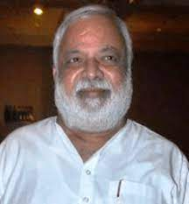
EXEMPLARY REPRESENTATIONS

Slide 13
PLEASE WRITE TO US AT: INFO@KHURANAANDKHURANA.COM, MEDIA.LAW@KHURANAANDKHURANA.COM PH: +120-4296878, 9810617992
Khurana & Khurana, Advocates and IP Attorneys
International Office:
US
UAE/GCC
Thailand
Malaysia
Myanmar
Vietnam
Bangladesh
Nepal
Sri Lanka
Domestic Offices:
New Delhi
Noida (NCR)
Pune
Mumbai
Bangalore
Indore
Hyderabad
Jalandhar
Chennai

Slide 14
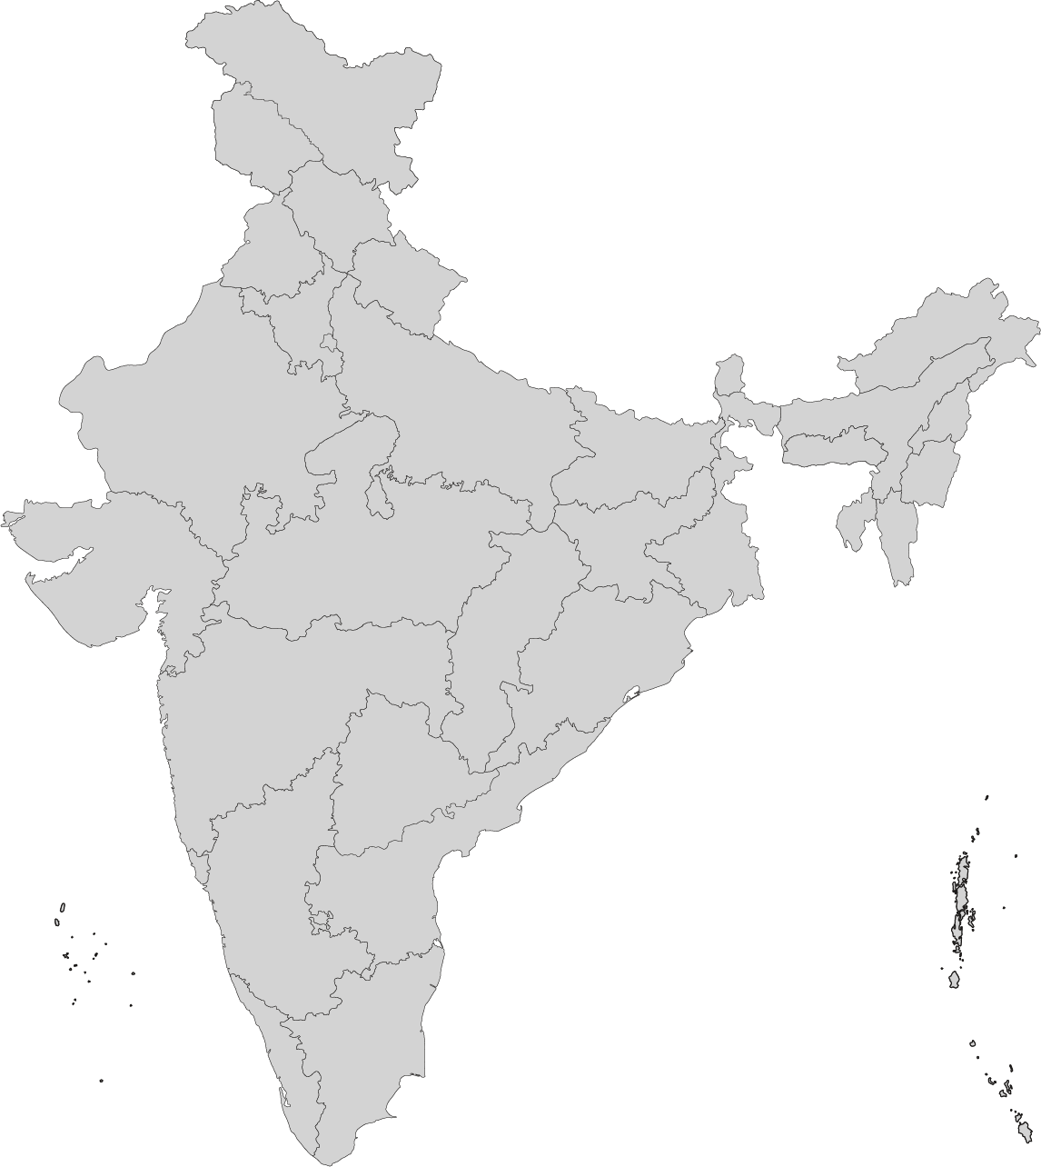
Contact us
Noida Office (Head Office)
E-13, UPSIDC, Site-IV, Behind-Grand Venice, Kasna Road, Greater Noida - 201310, UP, National Capital Region, India | Tel: +91 (120) 4296878, 4909201, 4516201
Delhi Office
S-378, 1st floor, Panchsheel Park, New Delhi, Delhi-110017, India | Tel: +91 (11) 40079530
Bangalore Office
S-378, 1st floor, Panchsheel Park, New Delhi, Delhi-110017, India | Tel: +91 (080) 41557220
Pune Office
Unit No. 1, Sampada Apartment, Plot No 395 & 396, Shree Krishna Nagar, Senapati Bapat Road, (Landmark- opposite Ratna hospital & Behind Vidya Sahakari Bank) Pune, Maharashtra - 411016, India | Tel: +91 (020) 25652120
Mumbai Office
B2-304, Kanakia Boomerang, 3rd Floor, Chandivali Farm Road, Chandivali, Powai, Mumbai-400072, India | Tel: +91 (022) 41002054
Indore Office
703, B Block, The One, RNT Marg, South Tukoganj, Indore - 452001, Madhya Pradesh, India | Tel: +91 (120) 4296878, 4909201, 4516201
Hyderabad Office
Cabin No:12, 3rd Floor, Coworkzone, Plot No:63, Beside Xenex, Kavuri Hills Phase1, Jubilee Hills PO, Hyderabad 500033, India | Tel: +91 (040) 67172040
Punjab Office
A2-905, Jal Vayu Vihar, Jalandhar, AFNHB, Punjab - 144008, India | Tel: +91 (120) 4296878, 4909201, 4516201
Chennai Office
AB 103 & 105, Suite A, 2nd Floor, 4th Avenue, Shanthi Colony, Anna Nagar, Chennai, Tamil Nadu - 600040, India | Tel: +91 (120) 4296878, 4909201, 4516201
K&K: info@khuranaandkhurana.com
media.law@khuaranaandkhurana.com
K&K: www.khuranaandkhurana.com
IIPRD: www.iiprd.com

